Slide 1
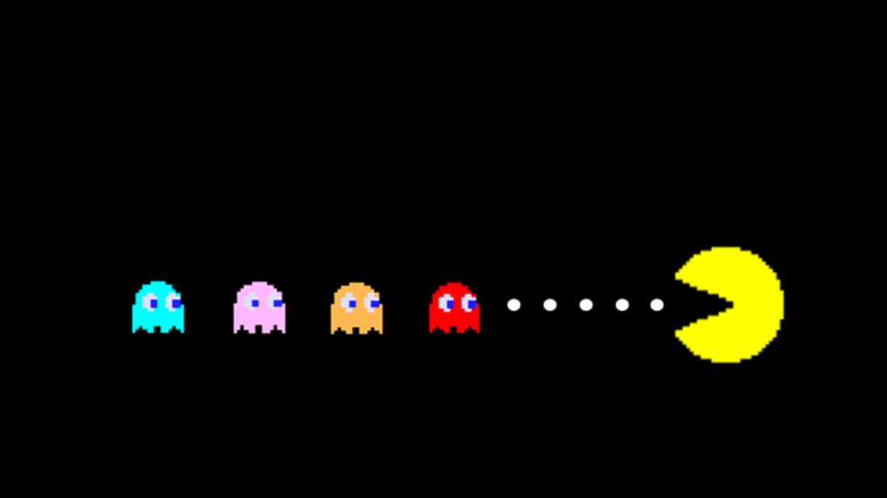

Pacman
By Jordan Srinivasan

Slide 2
What I Learned
Pacman is not as easy to code as it seems.
Majority of time coding is spent troubleshooting
Gained a higher understanding of how pygame and specific parts of python work (especially objects)
Many built in functions in pygame already

Slide 3
What I am Proud of
Trying something that was outside of my comfort zone
Actually attempting to code this at first
Being able to solve certain issues with my code on my own, without the assistance of another
Learning more about the wonders of pygame and python in general

Slide 4
Struggles
Trying to figure out how I would use objects in my code.
Ended up completely erasing code and starting a new one more than once
Had zero experience with pygame before this project
Trying to limit the amount of code I had

Slide 5
Works Cited
Brunofalmeida. “Pacman.” GitHub, 19 July 2016, github.com/brunofalmeida/Pacman-Pygame.
“Stack Overflow.” Stack Overflow, stackoverflow.com/.

